Slide 1
Analysis of the traveling salesman problem
By xin jin
121220307

Slide 2
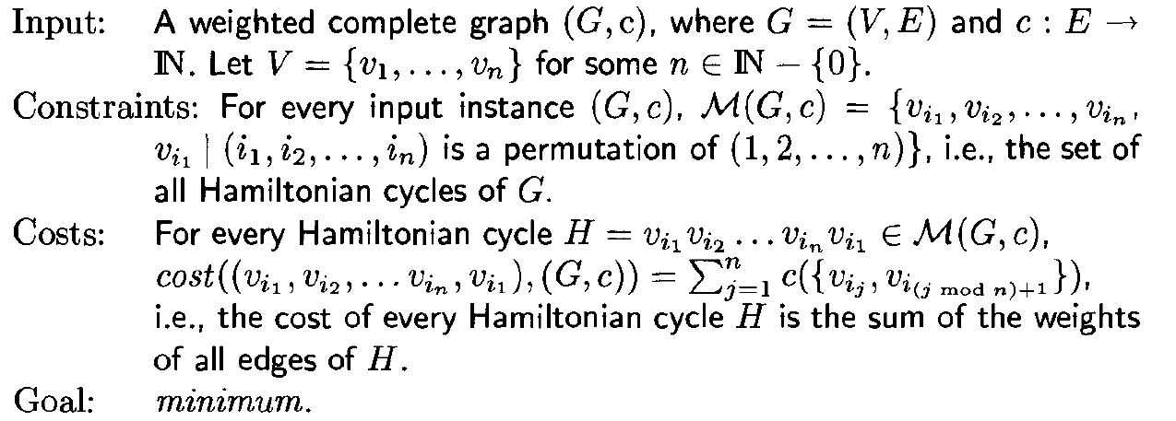
Problem description：
Given a list of cities and the distances between each pair of cities, what is the shortest possible route that visits each city exactly once and returns to the origin city?
Formal definition

Slide 3
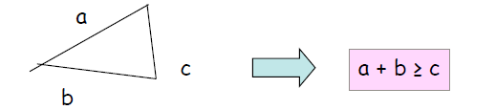
Approximation Algorithm:
Algorithms that runs in polynomial time and always produce a solution close to the optimal. We called an algorithm an α_approximation algorithm if it runs in polynomial time, and always outputs a solution that is at most α*OPT for a minimization problem
However, there is no α_approximation algorithm for general Traveling Salesman Problem where α is a constant.(We can prove this by using such an algorithm to solve the Hamiltonian Cycle Problem which is impossible).
Thus, my research is based on metric Traveling Salesman Problem whose edge costs have to satisfy the triangle inequality(for all x,y,z∈V，c(x,z)<=c(x,y)+c(y,z))

Slide 4
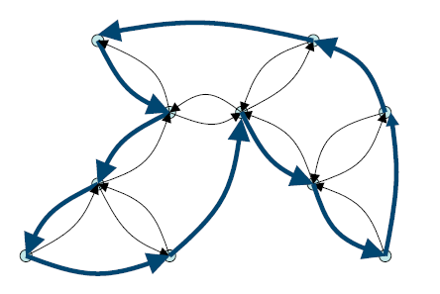
A 2-Approximation Algorithm for metric TSP
Find an MST, T , of G
Double every edge of the MST to obtain an Eulerian graph.
Find an Eulerian tour, T* , on this graph.
Output the tour that visits vertices of G in the order of their first appearance in T*. Let C be this tour(a short cut of T*).
Analysis:
cost(T)≤OPT
cost(T*)=2cost(T)
cost(C)≤cost(T*)
cost(C)≤2OPT

Slide 5
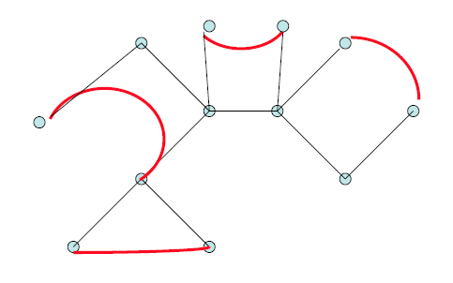
A Christofides’ Algorithm for Metric TSP ---3/2-Approximation Algorithm
Find an MST, T , of G
Find a matching M among odd degree vertices.
Find an Eulerian tour T* , on the graph with edges from T and M.
Output the tour that visits vertices of G in the order of their first appearance in T*. Let C be the tour(a short cut of T*).
Analysis:
cost(T)≤OPT
cost(M)≤1/2OPT
cost(C)≤cost(T*)≤cost(T)+cost(M)
cost(C)≤3/2OPT

Slide 6
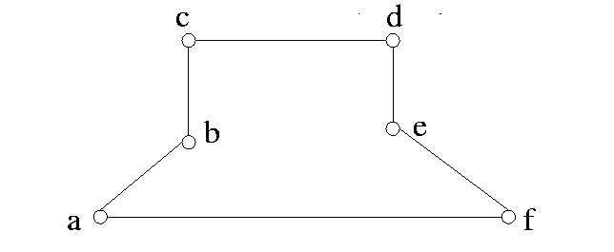
Greedy Algrithm
Start with city i (i=0,1,2,…,n-1)
Choose the next city with the minimum cost(i,j), j has not been visited before.
Continue above step, until all cities have been visited.
Calculate the cost Ci of the cycle.
Change the start city i , and find the minimum C among Ci.

Slide 7
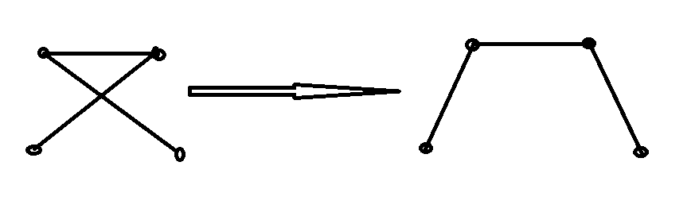
Iterative Algorithm
We generated an arbitrary initial solution using the greedy algorithm. Then do the following iteration.
Select two random cities
Interchange the two cities predecessors
Calculate the weight of resulting tour.
If new weight is smaller than old one, replace the old tour by the new one. Continue step 2 until we do the iteration for n^2 times

Slide 8
Algorithm accuracy rate comparison
Obviously, the algorithm with my strategy is much better than the original algorithm.

Slide 9
Thank you !

